Slide 1
Standard high torque motors are available up to about 55 kW for direct-on-line starting
  with the starting torque at least two times the full-load torque and
  the starting current about 350 % of the full load current.
Standard motors are also available for star-delta starting with T_{s} = 100 % of full load torque at starting in the star connection, the starting current being 150 to 175 % full load current.

Slide 2
High resistance cage motors
In this design efficiency is sacrificed.
The cage is made of brass.
The starting torque is higher and the locked rotor or starting current lower.
They are designed for intermittent operation to prevent overheating.

Slide 3
High resistance cage motors cont’d
They drive high inertia loads which take a relatively long time to reach full load speed e.g. centrifugal dryers.
The large drop in speed with increasing load makes them ideal for driving high impact loads such as punch presses, forge hammers etc that are required with flywheel.

Slide 4
Past questions on high-torque motors
Describe the construction of a double-cage rotor induction motor. [5 marks]
Discuss the principle of operation and the torque-speed characteristics of a double-cage rotor induction motor. [11 marks]

Slide 5
Induction generator
An induction machine can be made to generate by raising the rotor speed above the synchronous speed.
Like any other generator, an induction generator must be excited.
The excitation of an induction generator is by means of the magnetizing current in the stator.

Slide 6
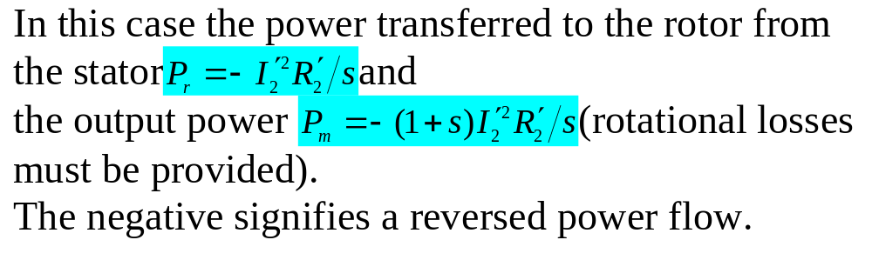
Generator equivalent circuit
This is the same as that of an induction motor in either the exact or approximate versions.
The slip is negative however, so that –s must be substituted for s, if s itself is still to symbolize a positive number.

Slide 7
Externally-excited induction generator
The excitation determines the flux and the frequency of the induction generator and consequently the synchronous speed above which the machine must run to generate.
For proper functioning, the induction generator must therefore be connected to some existing source or supply to supply it with magnetizing current and to fix its frequency.
The system also determines its voltage.

Slide 8
Externally-excited induction generator
The induction generator is useful when the prime mover does not run at constant speed since the stator frequency depends on that of the existing power supply.
The utilization of wind power is suitable application for this type of generator.
Currently induction generators driven by variable-pitch waterwheel turbines are also used as unattended hydroelectric generating station plants up to 100 kW.

Slide 9
Self-excited generator
The magnetizing current may be provided by capacitor bank.
With this method of excitation, the frequency and the generated voltage are affected by the speed, load and capacitor rating.
If the load is inductive the capacitor will have to supply the reactive power required by the load.

Slide 10
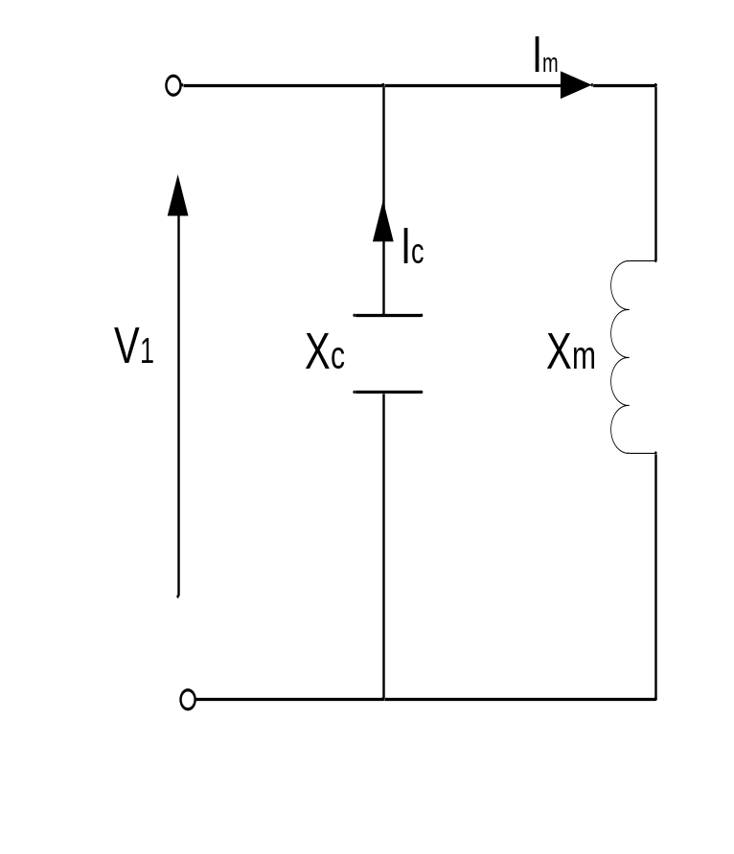
Self-excited generator on no load
On no load the slip is almost zero, and the equivalent circuit becomes

Slide 11
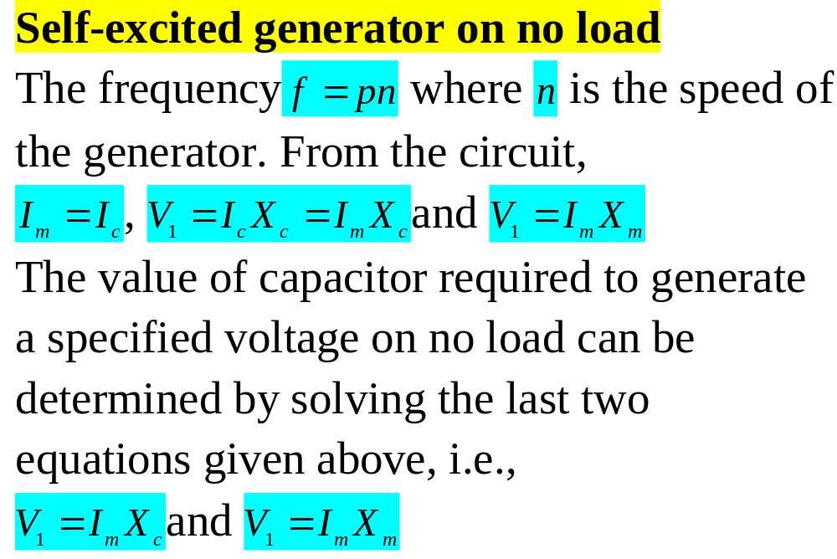

Slide 12
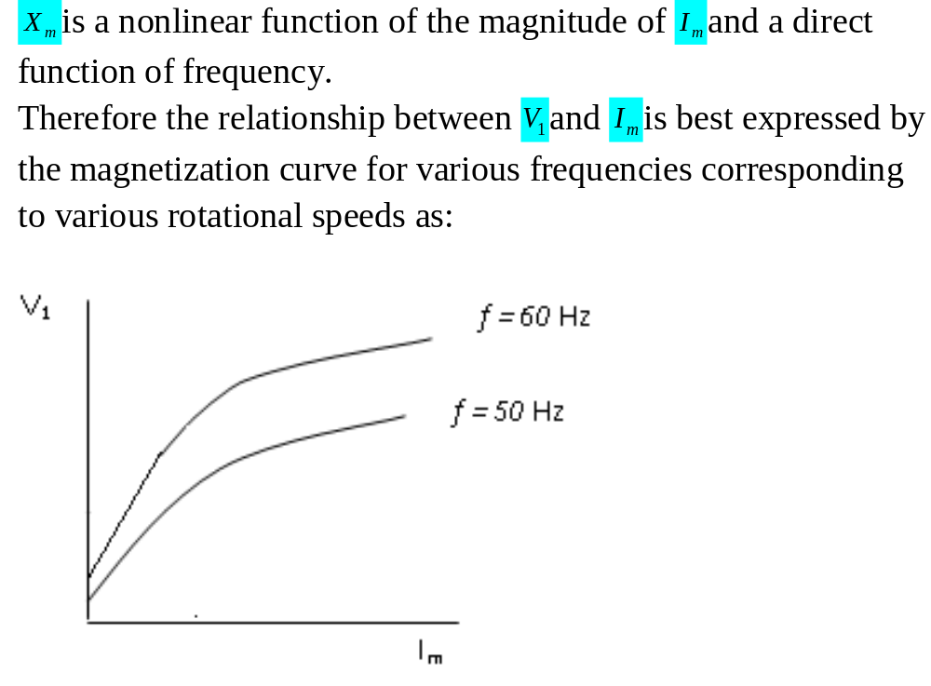

Slide 13
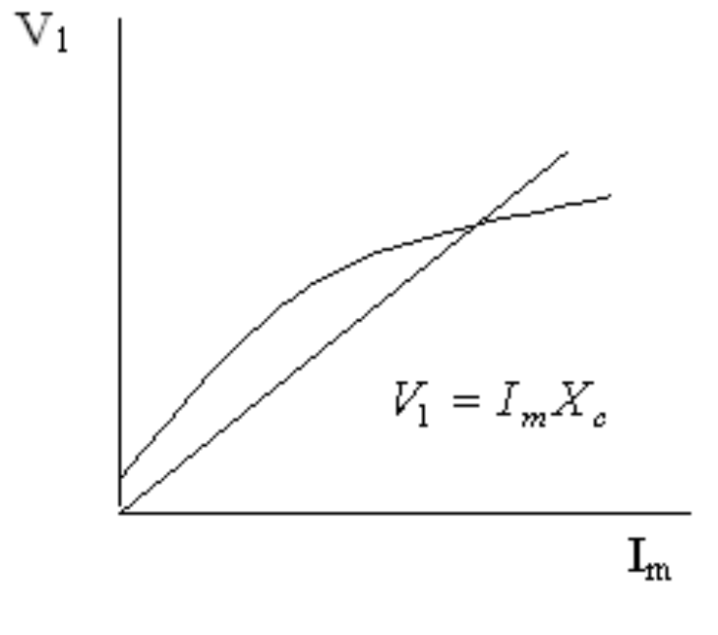
The value of the capacitor required to generate a specified voltage at a specified frequency can then be obtained graphically by plotting the voltage V₁ against the magnitude of I_{m} and plotting also the curve V₁ = I_{m} X_{c} and finding the point of intersection:

Slide 14
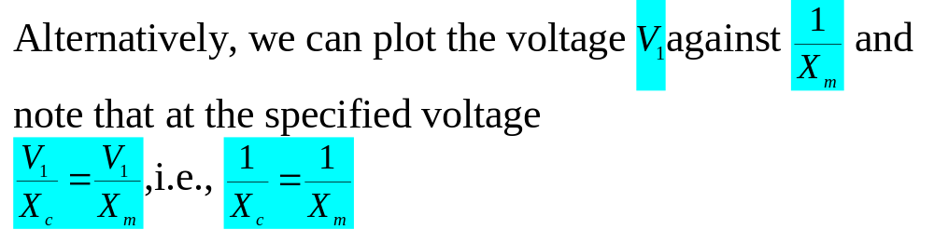
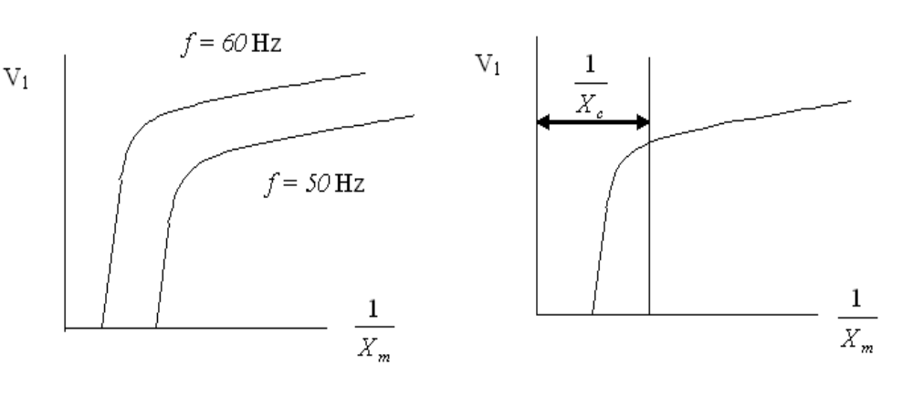

Slide 15
Self-excited generator on no load
It is to be noted that self-excitation is possible only
  when there is sufficient residual magnetism in the rotor
  the capacitive susceptance is at least as great as the minimum unsaturated susceptance.

Slide 16
Self-excited generator on no load
It follows from the second bullet that there is a critical value of capacitance below which the induction generator will not build up at a given speed.
Also there is a critical speed for a given capacitance.

Slide 17
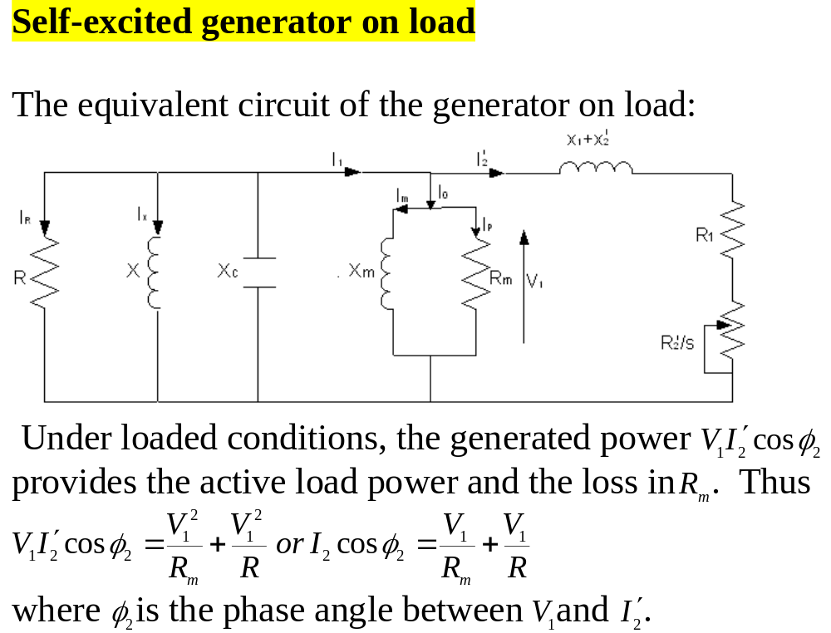

Slide 18
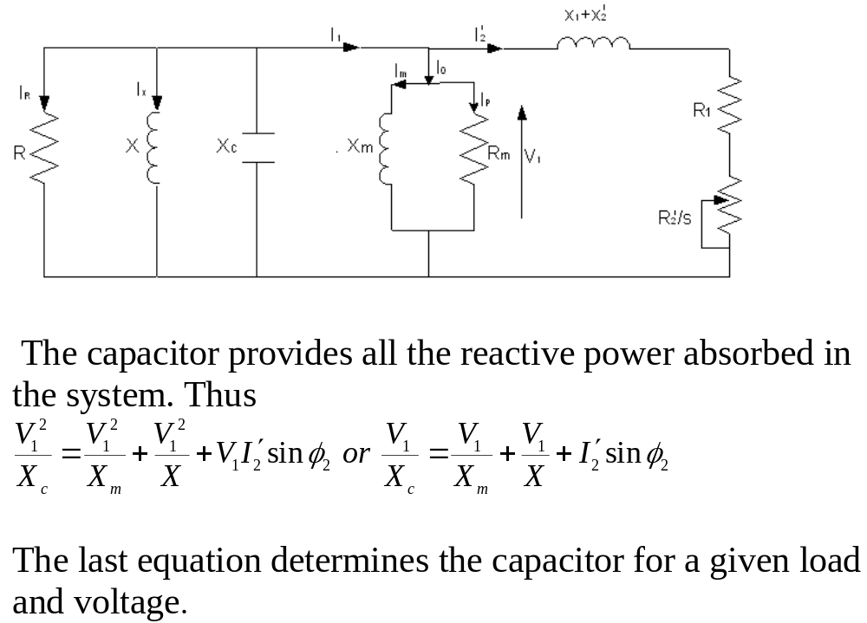

Slide 19
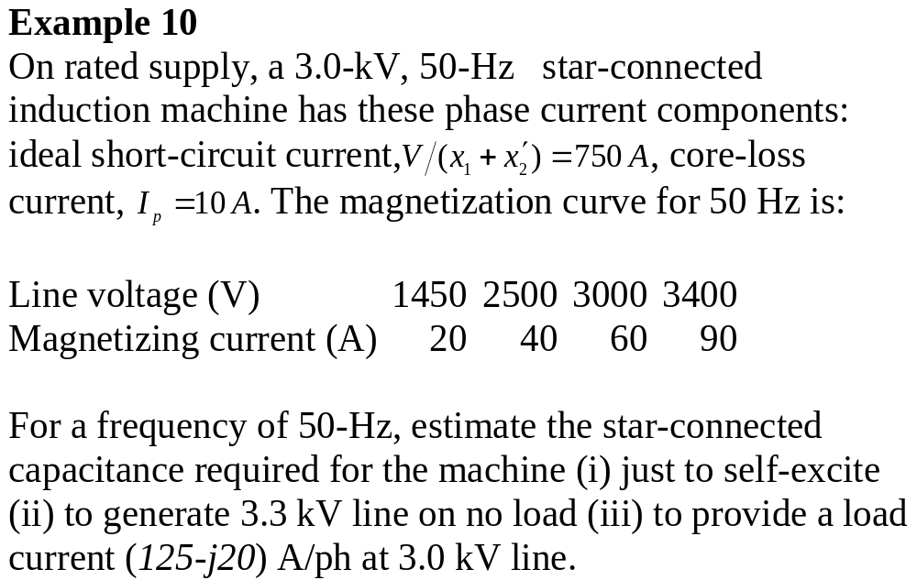

Slide 20
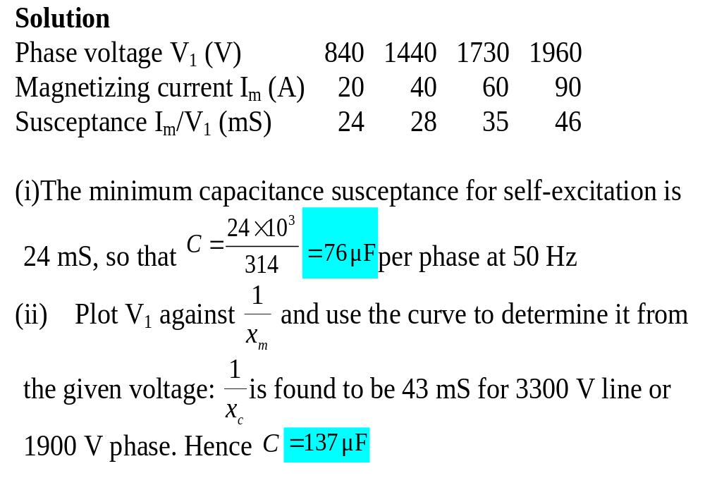

Slide 21
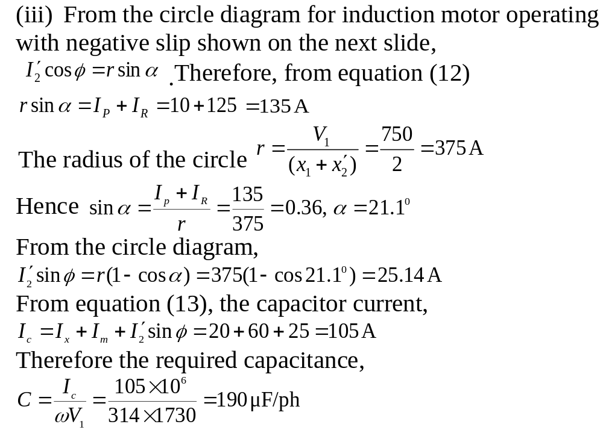

Slide 22
